Slide 1



The Dark Side of Operational Wi-Fi Calling Services
Tian Xie¹, Guan-Hua Tu¹, Chi-Yu Li², Chunyi Peng, Mi Zhang¹
¹Michigan State University
²National Chiao Tung University
³ Purdue University
Notes:
Thank you for the introduction.
In this talk, we will introduce

Slide 2
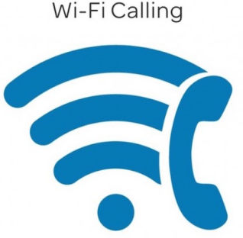

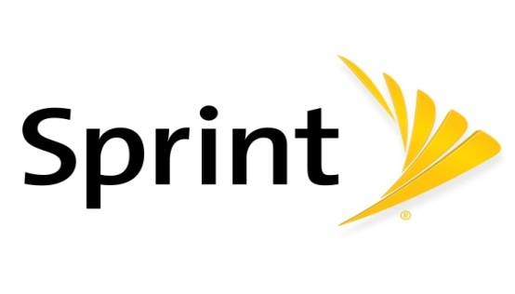

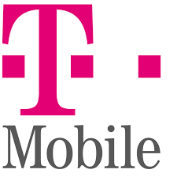
Wi-Fi Calling Services
Wi-Fi Calling services empower mobile users to access voice and text services over Wi-Fi instead of cellular networks.
All of four U.S. major operators have launched Wi-Fi calling services since 2016 – Verizon, AT&T, T-Mobile, and Sprint.
By 2020, Wi-Fi calling services will take 53% of mobile IP voice service usage including VoLTE (26%) and others (21%).
Notes:
1. Although currently the cellular network can cover majority areas, many people may still have the problem to contact others via the wireless cellular network, especially some building areas that the cellular signal may be affected.
2. While users are in an area where cellular signals are very strong , they can still use voice and text services over public or private WiFi networks.

Slide 3
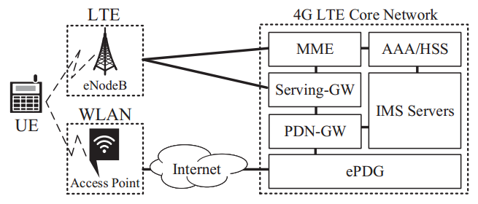
Wi-Fi Calling Services Primer
Specifically, they are SIP-based voice and text services, however, they are using a 3GPP-modified version.
Developed on top of 3GPP IMS (IP Multimedia Subsystem)
Operators use IMS to provide users with IP-based services such as VoIP
It uses the same infrastructure for VoLTE (Voice over LTE) users.
Radio Access Network (RAN)
Wi-Fi Access Point (Wi-Fi Calling)
eNodeB (VoLTE)
LTE Core Network (CN)
ePDG (Evolved Packet Data Gateway, Wi-Fi calling)
PDN-GW (Public Data Network Gateway)
AAA (Authentication, Authorization, and Accounting)
IMS (IP Multimedia Subsystem)
Notes:
The scripts are used to explain “It uses the same infrastructure…”as follows
The WiFi access point and ePDG are newly deployed for WiFi calling users.
For other network elements such as AAA, IMS servers, etc, WiFi calling users share them with VoLTE users.

Slide 4
Wi-Fi Calling Security Mechanisms
Using well-examined 3GPP Authentication and Key Agreement (AKA) and SIM-based security adopted by VoLTE – symmetric cryptography.
All Wi-Fi calling signaling and voice/text packets are delivered through IPsec (Internet Protocol Security) – ciphering and integrity protection.
How Does It Go Wrong if adversaries cannot control Wi-Fi routers serving Wi-Fi users?
Notes:
Since Wi-Fi calling service may transmit the data via the public WiFi network, malicious public Wi-Fi network which can freely drop every Wi-Fi calling service signaling and voice packets. Here is some WiFi calling security mechanisms.

Slide 5
Finding 1: Wi-Fi calling devices will activate Wi-Fi calling services over an insecure Wi-Fi network
Notes:
The answer to this question is yes. WiFi calling devices do not avoid to activate wifi calling services in an insecure wifi network.
Definition of insecure WiFi is that users will suffer from security threats launched from the WiFi networks.

Slide 6
Vulnerability: Wi-Fi calling devices do not exclude insecure Wi-Fi networks – (design defect of standards)
Vulnerability – Wi-Fi calling standards don’t exclude insecure Wi-Fi
Two Wi-Fi access point selection modes do not consider security factors yet!!
Manual (use a prioritized list)
Automated (ANDSF, Access network discovery and selection function)
Validation:
Deploy an insecure Wi-Fi network using a Wi-Fi router which is vulnerable to ARP spoofing attack – foundation of a variety of MITM attacks
I.e., victim’s WIFI packets will be intercepted and delivered to adversaries
We test whether the Wi-Fi calling devices keep connecting to the above Wi-Fi router
All tested Wi-Fi calling devices connected to the insecure Wi-Fi router!!!
Notes:
ANDSF (Access network discovery and selection function), which is mainly based on the capabilities and radio quality without considering the security of selected Wi-Fi network.
We validate it by deploying….

Slide 7
Finding 2: Wi-Fi calling devices do not employ security defense against the common Wi-Fi ARP spoofing attacks
Notes:
The answer to this question is yes. WiFi calling devices do not avoid to activate wifi calling services in an insecure wifi network.

Slide 8
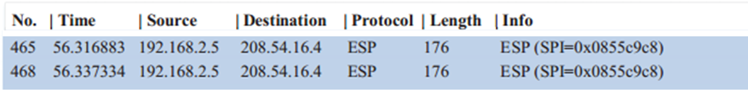
Vulnerability: Wi-Fi calling devices do not defend against ARP spoofing attacks –(implementation issue of devices)
Vulnerability -Wi-Fi calling devices always accept ARP Reply message
All packets sent by Wi-Fi calling devices can be redirected to adversaries
Validation
We use EtterCap to send ARP reply message to Wi-Fi calling devices.
Adversaries can capture all Wi-Fi packets sent by the victim
Notes:
Employing EtterCap to send spoofed ARP messages. Therefore, we can capture….

Slide 9
Finding 3: Wi-Fi calling devices and infrastructure indeed deploy extra security mechanisms for malicious Wi-Fi attacks, however, it is not enough.
Notes:
The answer to this question is yes. WiFi calling devices do not avoid to activate wifi calling services in an insecure wifi network.

Slide 10
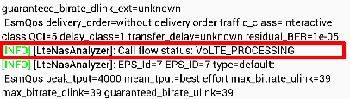
A system-switch mechanism for Wi-Fi Calling Service DoS Attacks
With the aforementioned two findings, adversaries can launch Wi-Fi Calling service DoS attacks
Discarding all intercepted Wi-Fi signaling and voice/text packets
System-switch (Wi-Fi-> Cellular)
If an user fails to dial a Wi-Fi voice call, the mobile device will switch to use cellular-network-based voice services.
If Wi-Fi calling service operators cannot route an incoming call to users by Wi-Fi calling, the operators will switch it to use cellular-network-based one.
For users, they are free of voice/text DoS attacks.

Slide 11
Vulnerability: Service continuity is not revised accordingly – (design defect of standards)
Service continuity can seamlessly switch an ongoing Wi-Fi calling call to back to cellular-network-based voice call
However, it is only triggered while the quality of Wi-Fi radio signals is bad
We start dropping all Wi-Fi calling packets after the call conversation is started (Wi-Fi radio quality is good)
What if Wi-Fi radio quality is good but Wi-Fi calling service quality is poor?
The system-switch security mechanism is bypassed!!
No cellular-based voice call is initiated.
Notes:
We are shocked because it bypasses the system-switch security mechanism. No cellular-based voice call is initiated

Slide 12
Finding 4: Wi-Fi calling service operators do not take extra security mechanisms to protect the encrypted Wi-Fi calling packets
Notes:
The answer to this question is yes. WiFi calling devices do not avoid to activate wifi calling services in an insecure wifi network.

Slide 13
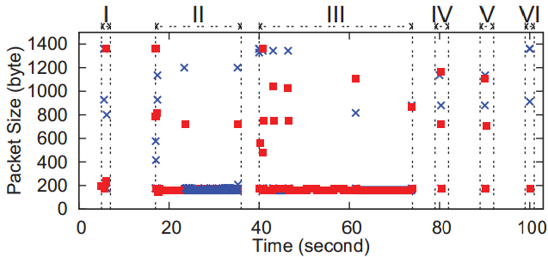
Vulnerability : The Wi-Fi calling traffic is vulnerable to side-channel attacks – (operational slip of operator)
Vulnerability -Wi-Fi calling is the only service that is carried by the IPSec channel between the mobile device and ePDG.
Adversaries may infer various Wi-Fi calling events such as dialing calls, receiving calls, etc.
Validation
Apply C4.5 to analyze IPSec traffic patterns
We are able to infer six Wi-Fi calling events
Evt I: Activating Wi-Fi calling service
Evt II: Receiving an incoming call
Evt III: Dialing an outgoing call
Evt IV: Sending a text
Evt V: Receiving a text
Evt VI: Deactivating Wi-Fi calling service
Notes:
As I mentioned in the beginning, the Wi-Fi calling traffic is protected by the IPSec. However, based on our study, we found that it is still vulnerable to side-channel attacks since Wi-FI calling service is the only service transmitted through the IPSec channel between mobile device and ePDG. It may be exploited to leak user privacy in terms of Wi-Fi calling service events.
After analyzing the patterns of Wi-Fi calling traffic, we discover six service events: dialing/receiving a call, sending/receiving a text message, and activating/deactivating the service as shown in the figure.
X is uplink packets. Red rectangle is downlink packets.

Slide 14
Two Proof-of-concept Attacks

Slide 15
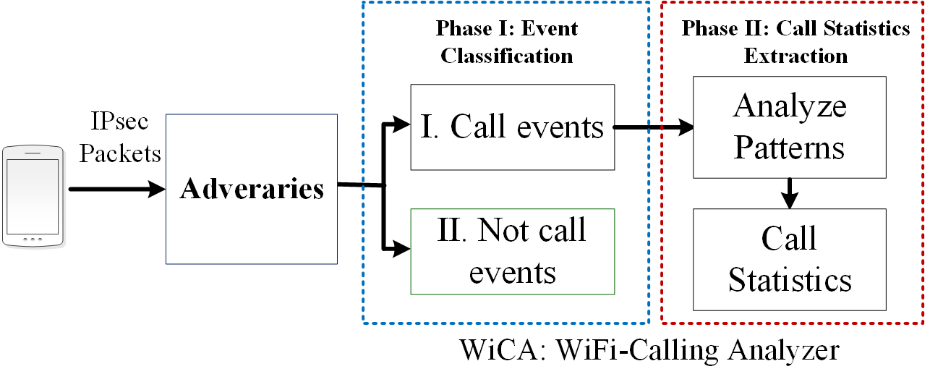
Attack 1: User privacy leakage
The call statistics has been proven effective to infer user privacy including personality[1], mood[2], malicious behaviors[3], etc.
Devising WiCA (Wi-Fi Calling Analyzer) to infer a Wi-Fi calling user’s call statistics
Who initiates the call (an incoming call or an outgoing call)
Who hangs up the call first (caller or callee)
Ringing time (how long the callee answers the call)
Call conversation time
[1] Y.-A. de Montjoye, J. Quoidbach, F. Robic, and A. S. Pentland, “Predicting personality using novel mobile phone-based metrics,” in International conference on social computing, behavioral-cultural modeling, and prediction. Springer, 2013
[2] S. Thomee, A. H ´ arenstam, and M. Hagberg, “Mobile phone use and ¨ stress, sleep disturbances, and symptoms of depression among young adults-a prospective cohort study,” BMC public health, vol. 11, no. 1, p. 66, 2011.
[3] V. Balasubramaniyan, M. Ahamad, and H. Park, “Callrank: Combating SPIT using call duration, social networks and global reputation,” in CEAS’07, 2007
Notes:
In this proof-of-concept attack, we devise WiCA to infer a Wi-Fi calling user’s call statistics, including who initiates the call, who hangs up the call, ringing time of call, and conversation time of call. E.g., we may use how many times the person hangs up the call to infer whether he/she is an aggressive person.

Slide 16
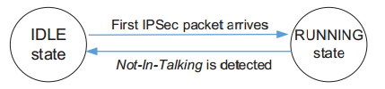
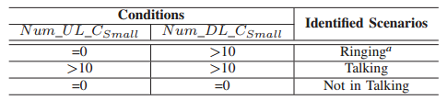
Infer call statistics@WiCA
WiCA’s finite state machine
Record the number of Uplink and Downlink packets transmitted every 2 seconds
Classify them into three categories by packet size:
Small (<200 bytes), Medium(200-800 bytes), Large (>800 bytes)
Our observations on small packets
Notes:
When it runs, it will determine 3 events, ringing, talking, not in talking.
Based on our study, we observe that when a time window containing 0 small uplink packets and more than 10 small dl packets is normally Ringing event. A time window containing more than 10 UL and DL small packets is Talking status. A time window containing 0 UL and DL small packets is Not in Talking status.

Slide 17
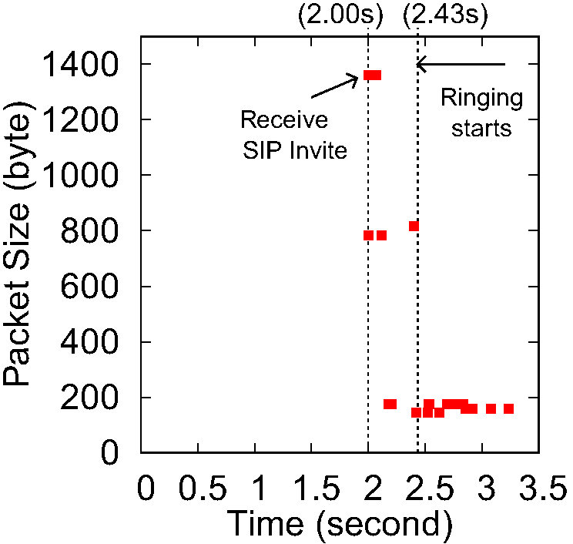
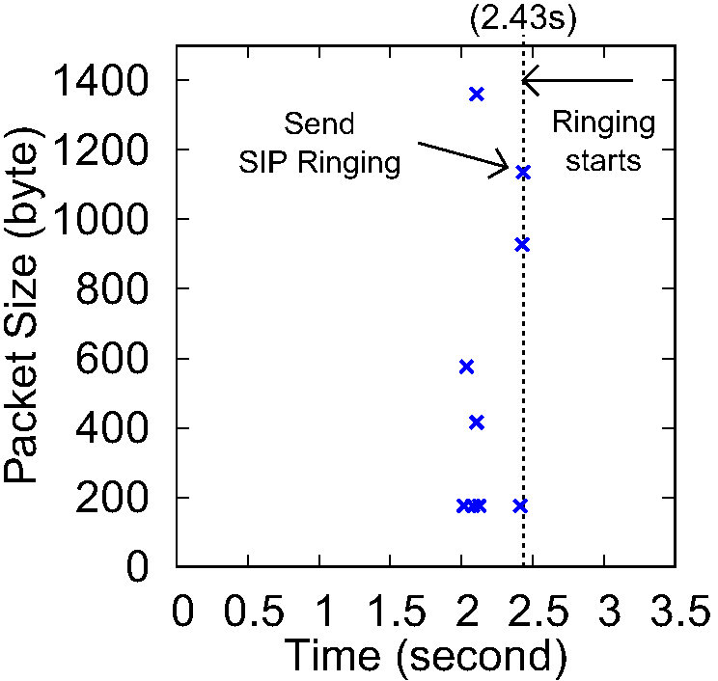
Ringing time inference
We observe that Wi-Fi calling service servers will keep sending small packets to both of caller and callee after SIP RINGING message is sent by the callee.
No uplink small packets after callee’s phone is ringed
Small downlink packets can be used to detect Ringing
Packets sent by Wi-Fi calling server
Packets sent by the callee
Packet arrivals for the event ‘receiving a call with a ringtone’ (callee perspective).

Slide 18
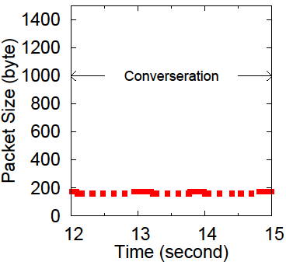
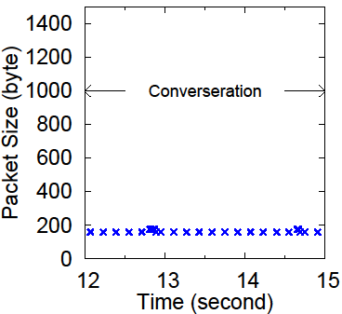
Conversation time inference
We observe small packets on the uplink and downlink during the call conversation
Packets sent by Wi-Fi calling server
Packets sent by the callee
Packet arrivals for ‘Talking’ (callee perspective).
Notes:
Here is an example of a incoming WiFi calling call. Again, Red rectangle is downlink packets. X is uplink packets. We can see that after the ringing start, there will be only small downlink packets. In the conversation, we see lots of small packets in both downlink and uplink.

Slide 19
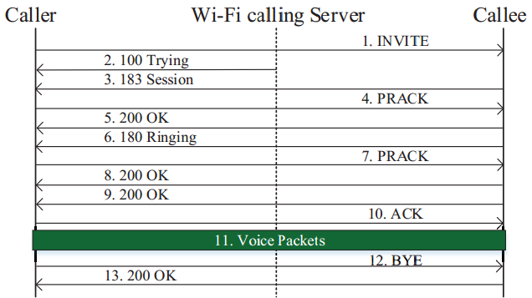
Call initiation and termination inference
Relying on the directions and patterns of large packets
E.g., if the ringing or talking event is detected and the first large packet (SIP INVITE) is sent by the monitored Wi-Fi user => It is an outgoing call
E.g., if the talking and not-talking events are detected and the last large packet (200 OK) is sent by the Wi-Fi server => the monitored Wi-Fi user terminates call first
Notes:
We can see that after the ringing start, there will be only small downlink packets. In the conversation, we see lots of small packets in both downlink and uplink.

Slide 20
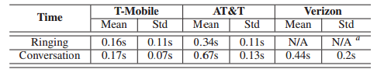
Performance of WiCA
Who initiates, Who ends call first : 100% accurate
Ringing time and conversation time
Maximum error is less than 0.8 seconds.
Notes:
In our experiment, We dial more than 50 outgoing calls and receive more than 50 incoming calls. All experiments successfully identified the person who initiates the call, who hangs up first.
Verizon does not send small voice packets to the Wi-Fi calling user when the callee’s phone is ringing

Slide 21

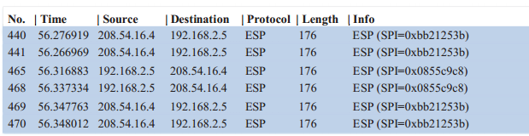
Another application of WiCA
By face recognition, It is not difficult to identify who you are
How about their IP addresses if they are using free public WiFi?
Xie
Tu
Peng
Li
Mi
Xie?
Peng?
Notes:
Currently, there are a lot of public WiFi networks free for use, such as the WiFi network provided by Starbucks and the universities. In this scenario, it is very difficult for mapping each user’s IP and his/her identification.

Slide 22
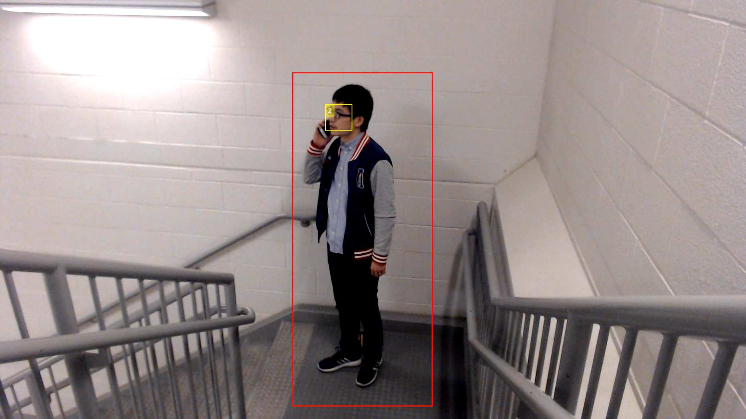
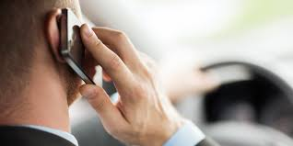
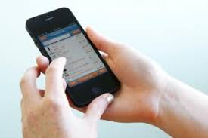
WiCA with visual recognition system
With the mature visual recognition system, WiCA’s call statistics can help to identify both of user identities and their IP addresses
The ways people are surfing and talking on phones are different
We know which of IP addresses is to initiate Wi-Fi calling call and its call statistics.
Notes:
Also, combining the mature visual recognition techniques, we can associate user’s IP with his/her identification. With the help of WiCA, we are able to a peron’s WiFi calling call statistics including his/her IP address. Then, using motion detection of answering the call, we can find who answer the call in the same detecting time by WiCA and associate the IP with this person.
We believe that this technology may be widely used for security purpose, such as in airport, the secure people can monitor the suspect people’s electric device by analyzing their Internet traffic.

Slide 23
Attack 2: Telephony harassment or denial of voice service attack (THDoS)
We devise a telephony harassment or denial of voice service attack against Wi-Fi calling users.
It can bypass the security defenses deployed on Wi-Fi calling devices and the infrastructure.
The attack is based on the manipulation of the delivery of Wi-Fi calling signaling and voice packets for an ongoing call.
It contains several variants.
Notes:
In the following, we first introduce the Wi-Fi calling call flow, and then present attack evaluation and real-world negative impacts.

Slide 24
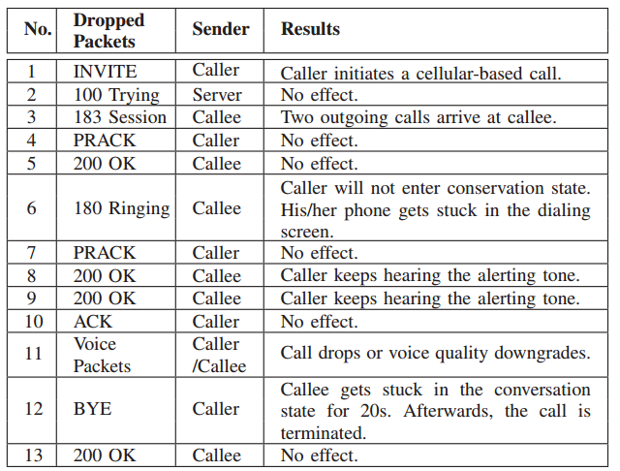
Results of Discarding Wi-Fi Signaling and Voice packets
Wi-Fi calling Call Flow
Notes:
We launch an ARP spoofing attack to intercept all packets between the router and victim device. Based on the identified traffic characteristics of WiFi calling calls and WiFi calling call flow, we are able to identify specific signaling packets and voice packets. So that we launch different kinds of attack by dropping different packets. Right table summarizes the attack result.

Slide 25
Four Call Attack Variants
Attack Wi-Fi signalings
Annoying-Incoming-Call Attack – keep receiving calls
Caller will be forced to get stuck in the dialing screen without any altering tone
Discarding 180 Ringing message
Zombie-Call Attack – a call cannot be ended
The caller’s device gets stuck in the dialing screen and will keep hearing the altering tone without starting the conversation.
Discarding 200 OK message

Slide 26
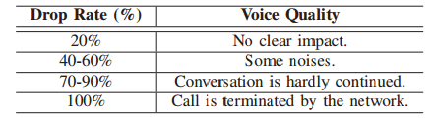
Four Call Attack Variants (cont.)
Attack Wi-Fi voice packets
Mute Call Attack – a muted call
Can only mute a call for 8s, call will be terminated by network
Not terminate the call but only mute the call
Telephony Denial-of-Voice-Service Attack
Can make the conversation be hardly continued
Notes:
We can control the voice quality by controlling the drop rate of voice packets.

Slide 27
Real-world Impact
We find that Wi-Fi calling users will suffer from the devised proof-of-concept attacks, specifically for the users who are using campus Wi-Fi
Usually provide their faculty, staff, students, and guests with free Wi-Fi
However, they are not always secure (cannot defend against our attacks)
MSU
New York University
University of California Berkeley
Northeastern University
etc

Slide 28
Solutions
Notes:
First, we’ll introduce the vulnerabilities we found under each question.

Slide 29
Solutions
Short-term: Using Virtual Private Network (VPN) service
It aims to increase the difficulty of launching side-channel attacks
Adversaries cannot easily infer each Wi-Fi calling service signalings/voice/text packets
Long-term: Revisit Wi-Fi calling service standards
Stipulate required security mechanisms which defends against the state-of-the-art Wi-Fi based attacks
Empower both Wi-Fi calling device and infrastructure to detect whether users are under the attack by monitoring the quality of Wi-Fi calling services and take actions (e.g., excluding malicious Wi-Fi networks)
Revise the current service continuity procedure from security perspective
Notes:
VPN: we have confirmed that the proof-of-concept attacks don’t work when using VPN. Though the short-term solution may not completely eliminate security threats, we believe it can significantly reduce the real-world damages.
. E.g., Modify 3GPP standards (SRVCC/DRVCC) to handover Wi-Fi users between Wi-FI and cellular network

Slide 30
Conclusion
We conducted the first security study on exploring the dark side of operational Wi-Fi calling services provided by three major U.S. operators as well as their commodity Wi-Fi calling devices.
Four security vulnerabilities are discovered, which stem from design defects of Wi-Fi calling standards, operational slips of operators, and implementation issues of Wi-Fi calling devices.
We demonstrate the negative real-world impacts (e.g., WiFi DoS) by two proof-of-concept attacks and provide recommended remedies.
Our lessons learned can secure both Wi-Fi calling service users and operators and facilitate its global deployment, as well as provide new design insights for upcoming 5G networks.
Notes:
We devise two proof-of-concept attacks by exploiting the identifies vulnerabilities and assess their impacts in those three U.S. carriers’ networks.
The Wi-Fi calling service is still at its early rollout, so the lessons learned from three major U.S. carriers can help secure mobile ecosystem and facilitate the global deployment, as well as provide new design insights for upcoming 5G networks.

Slide 31

Thank you! Questions?

Slide 32
Backup

